Slide 1
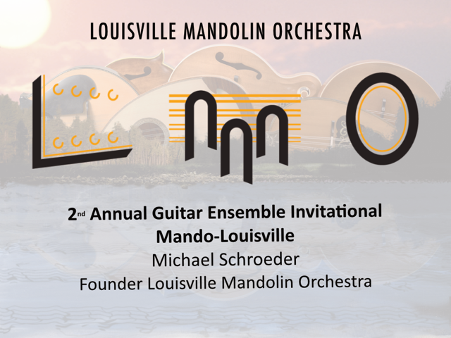
Notes:
Welcome
What is a mandolin?
What is a mandolin orchestra?

Slide 2
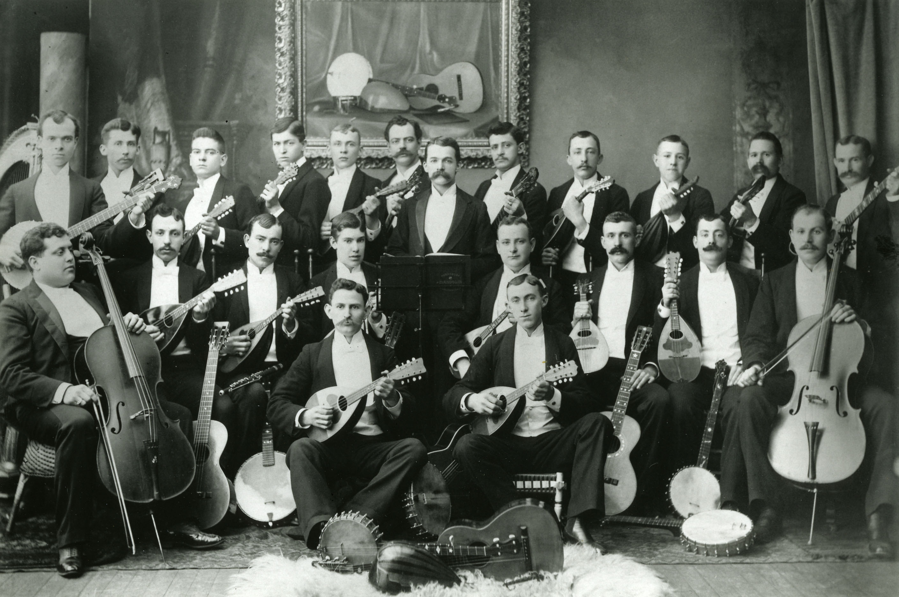
Notes:
Orpheus Mandolin Orchestra
of Louisville, KY.
Organized January 15, 1892
Prof. H. L. B. Sheetz Director
In Greek mythology Orpheus was a musician and poet.
Photo from Filson Historical Society

Slide 3
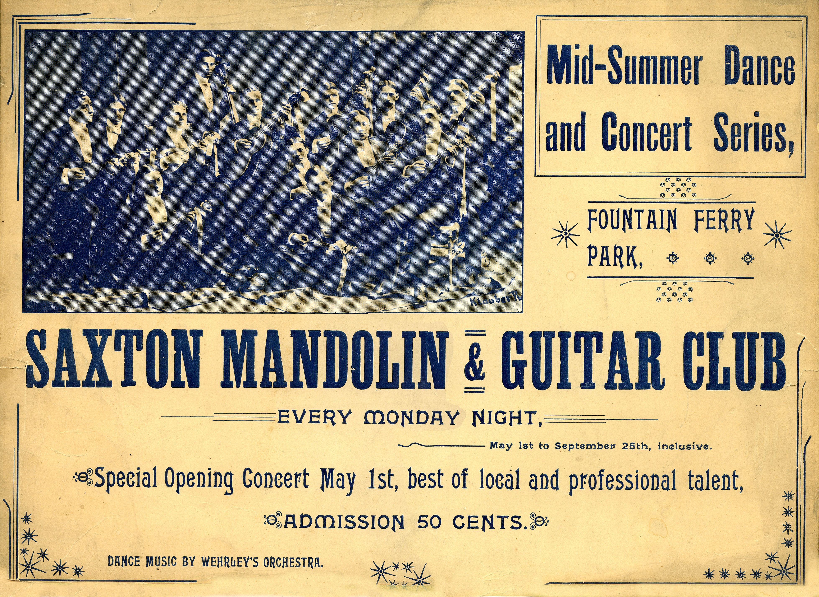
Notes:
Saxton Mandolin & Guitar Club
Fountaine Ferry Park was an amusement park which opened in 1905 and was located in Louisville's West end on the Ohio River.

Slide 4
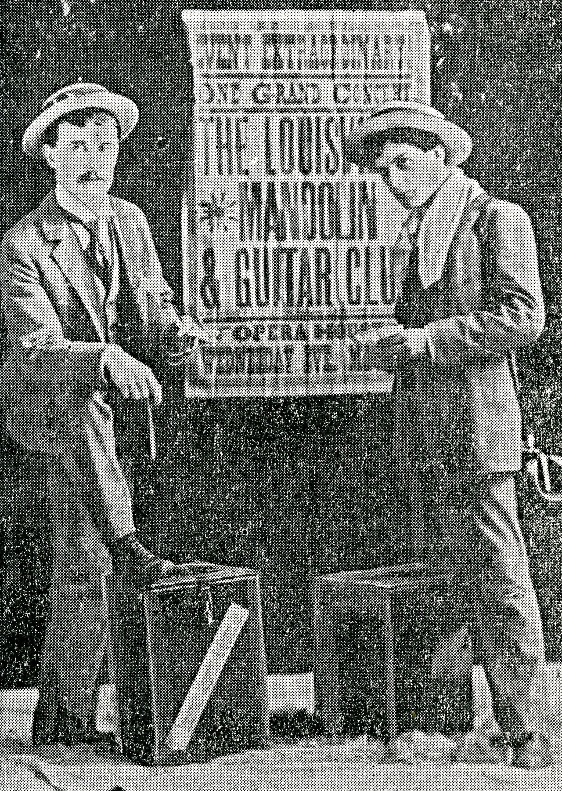
Notes:
Louisville Mandolin and Guitar Club
Event Extraordinary
One Grand Concert
Mr. R. W. Langan (pictured at left) founded the Louisville Mandolin and Guitar Club.

Slide 5
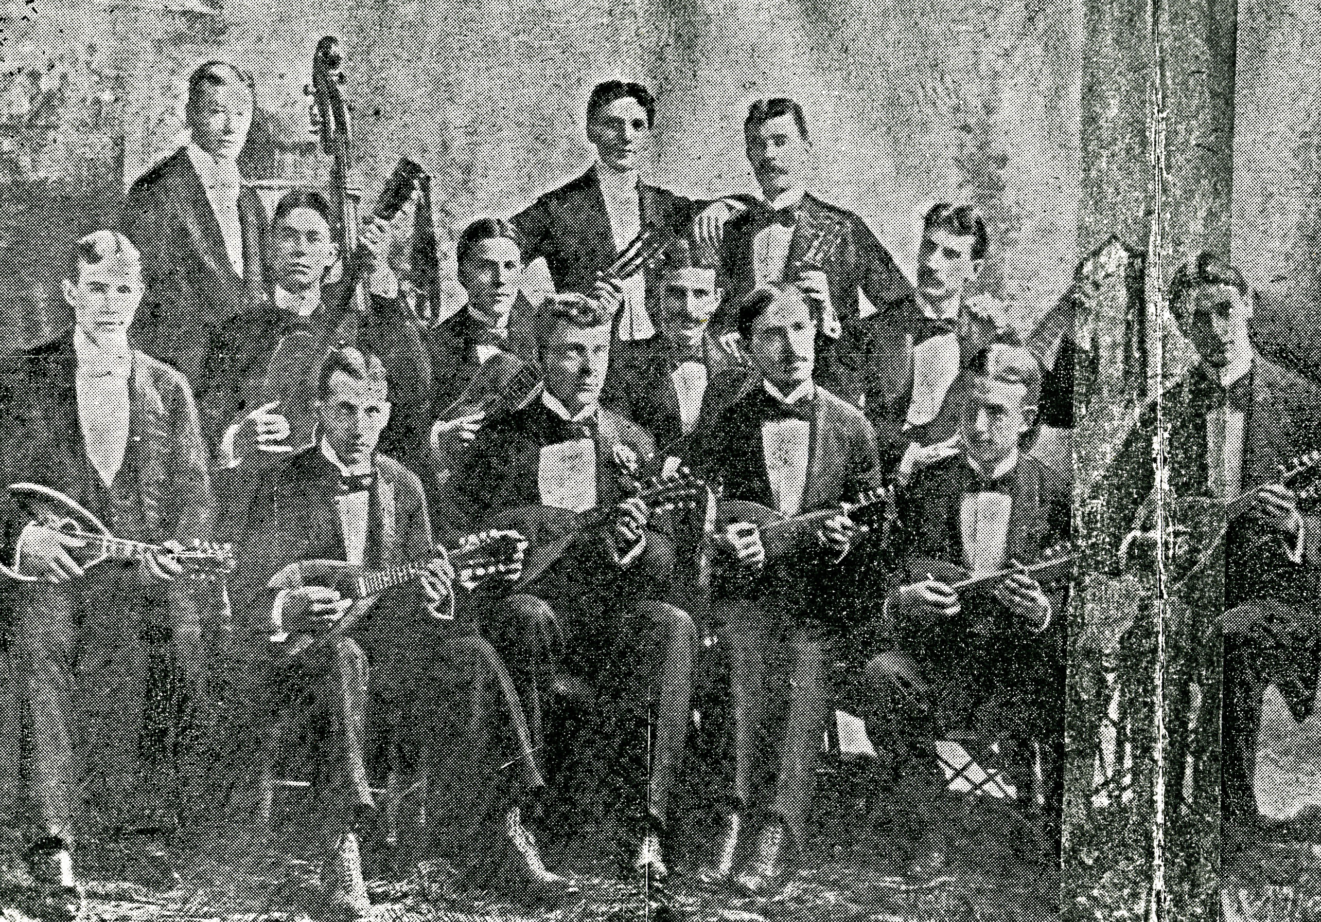
Notes:
From the Memorial History of Louisville (Filson Historical Society)
The Louisville Mandolin and Guitar Club was organized in June, 1891, with 11 members, and has earned a reputation second to no similar organization in the country. The club is social, musical and benevolent in character and always has been among the first to promote and respond to entertainments for charitable purposes. The proceeds of all concerts are turned over to some well know public charity. The club now fifteen members and has a handsomely furnished club room on Fourth Avenue. On two occasions has serenaded Signor A. Arditi and Adelina Patti, and from these famous persons has received the highest praise. The management has always been in the hands of Mr. R. W. Langan, who was the originator of the club, and it is mainly due to his untiring efforts that the organization has reached its present standing and efficiency.

Slide 6
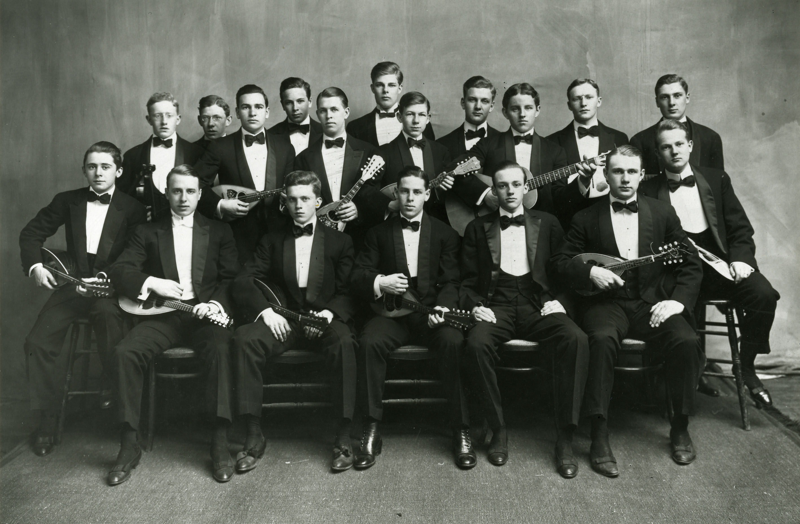
Notes:
Unidentified mandolin orchestra
Filson Historical Society

Slide 7
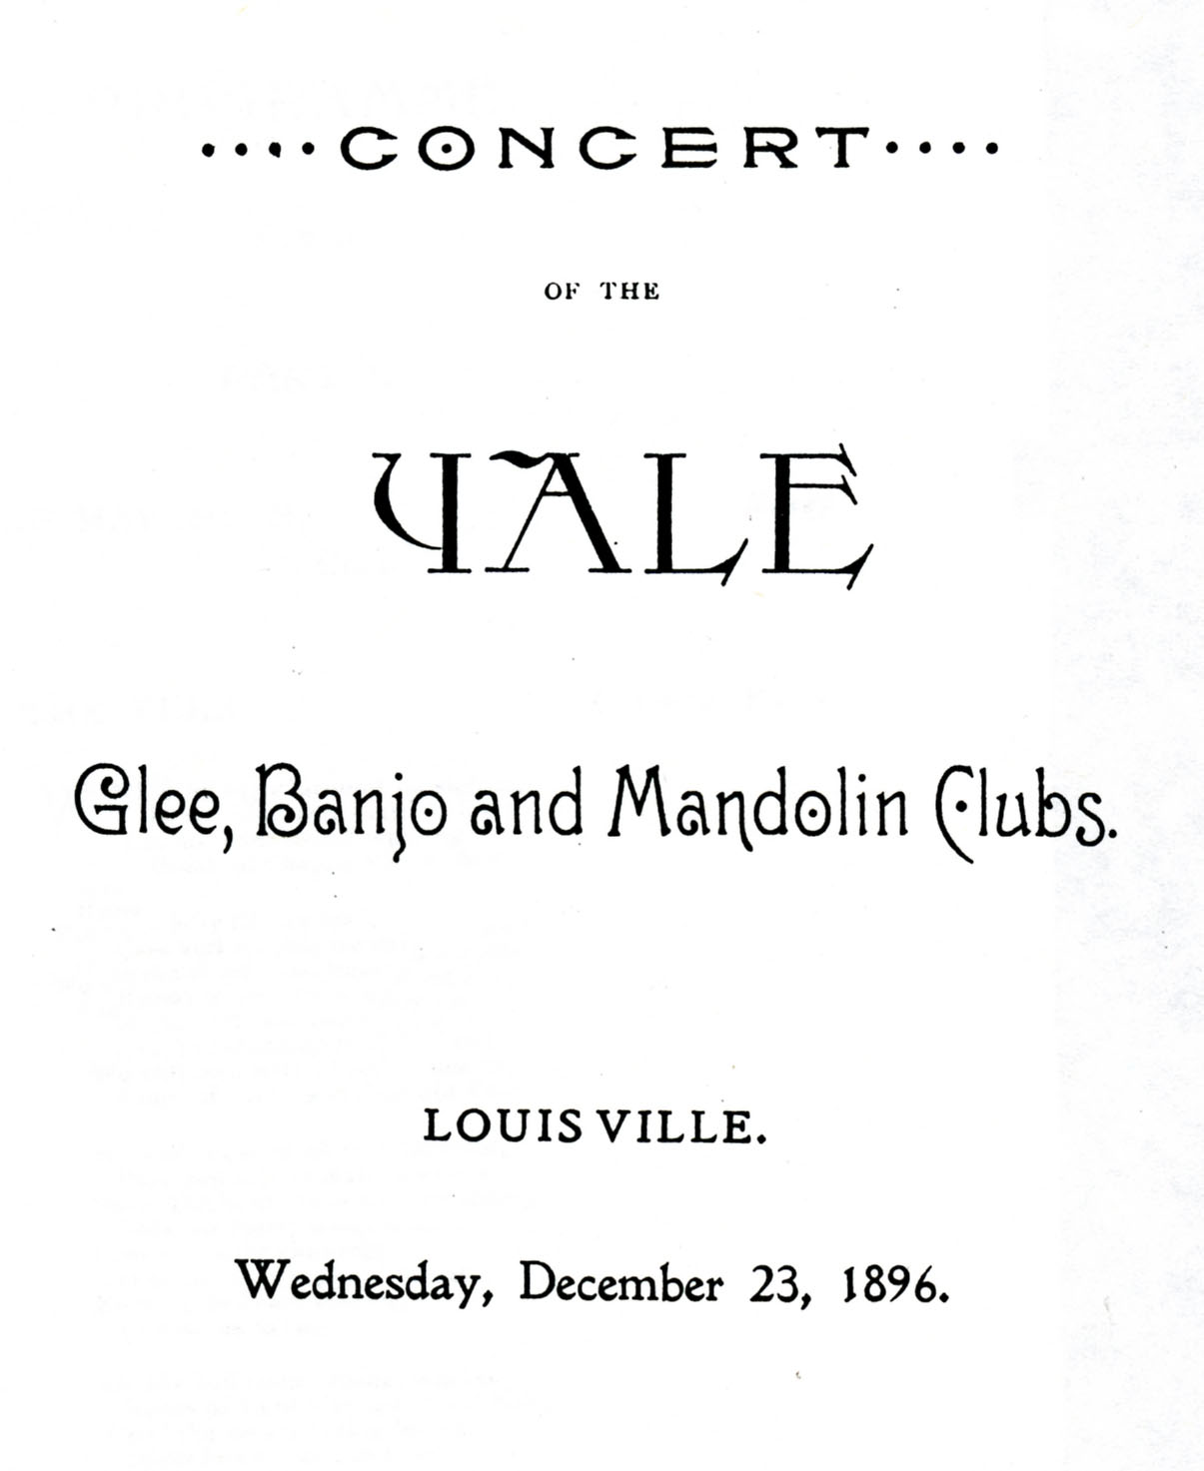
Notes:
Concert Program by the Yale Mandolin Club in Louisville KY December 23, 1886

Slide 8
Yale Daily News
New Haven, Conn.
Announcement of Itinerary for Vacation Tour
Wednesday, December 29, 1909 Louisville.
3:00 a.m., leave St. Louis via Southern Railroad. 11:00 a.m., arrive in Louisville. 1:00 p.m., Luncheon and Dance by Mr. and Mrs. Gilbert Sedgwich Cowan, Ayerstead Cherokee Park. 8:15 p.m., Concert at Woman’s Club, Fourth Avenue, near Oak Street. 10:30 p.m., Dance by Louisville Alumni at Woman’s Club. Local Manger, Thomas L. Jefferson, Jr.
Thursday, December 30, 1909 Nashville.
8:10 a.m., leave Louisville via Louisville and Nashville Railroad.

Slide 9
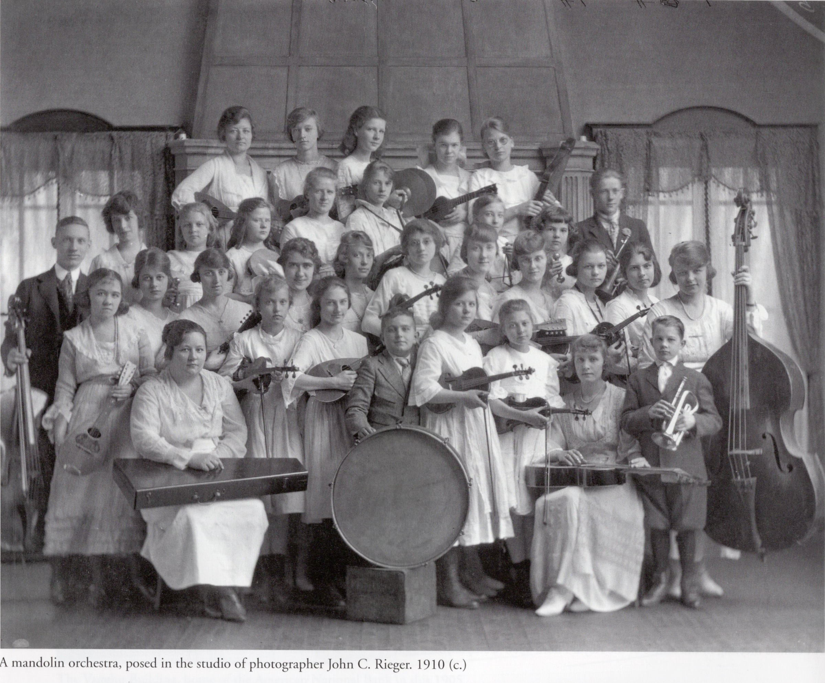
Notes:
From Historic Photos of Louisville – unnamed mandolin orchestra 1910.

Slide 10
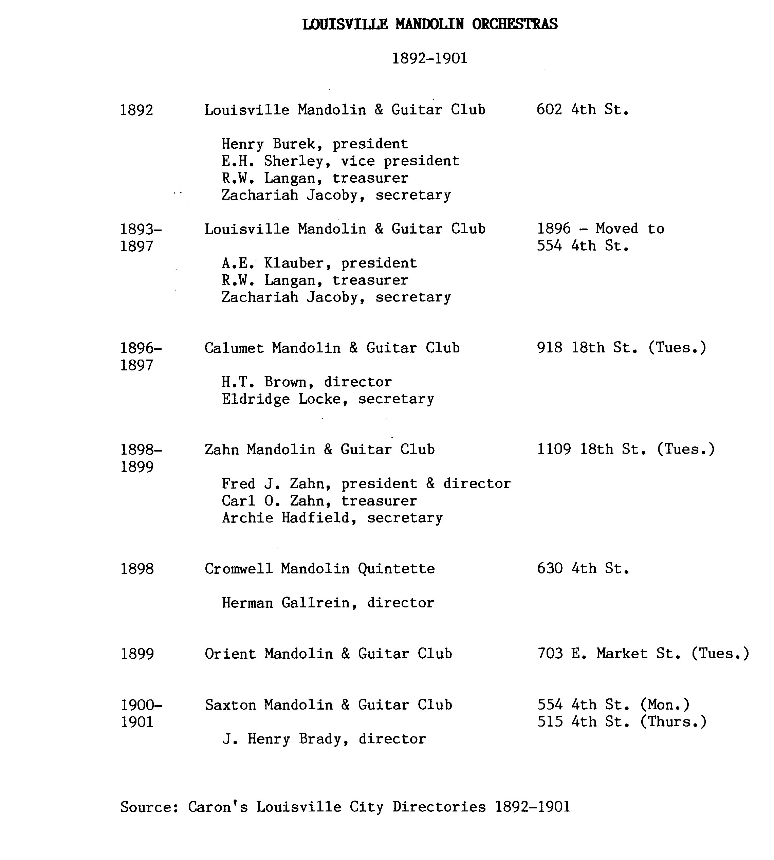
Notes:
Caron's City Directories 1892-1901
Louisville Free Public Library

Slide 11
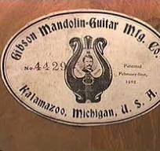
Orville H. Gibson
(1856 – 1918)
Gibson Mandolin-Guitar Manufacturing Company

Slide 12
Bill Monroe (1911 – 1996)
The Father of Bluegrass
July 9, 1923 Lloyd Loar Gibson F-5
Rod Stewart Maggie May 1971

Slide 13
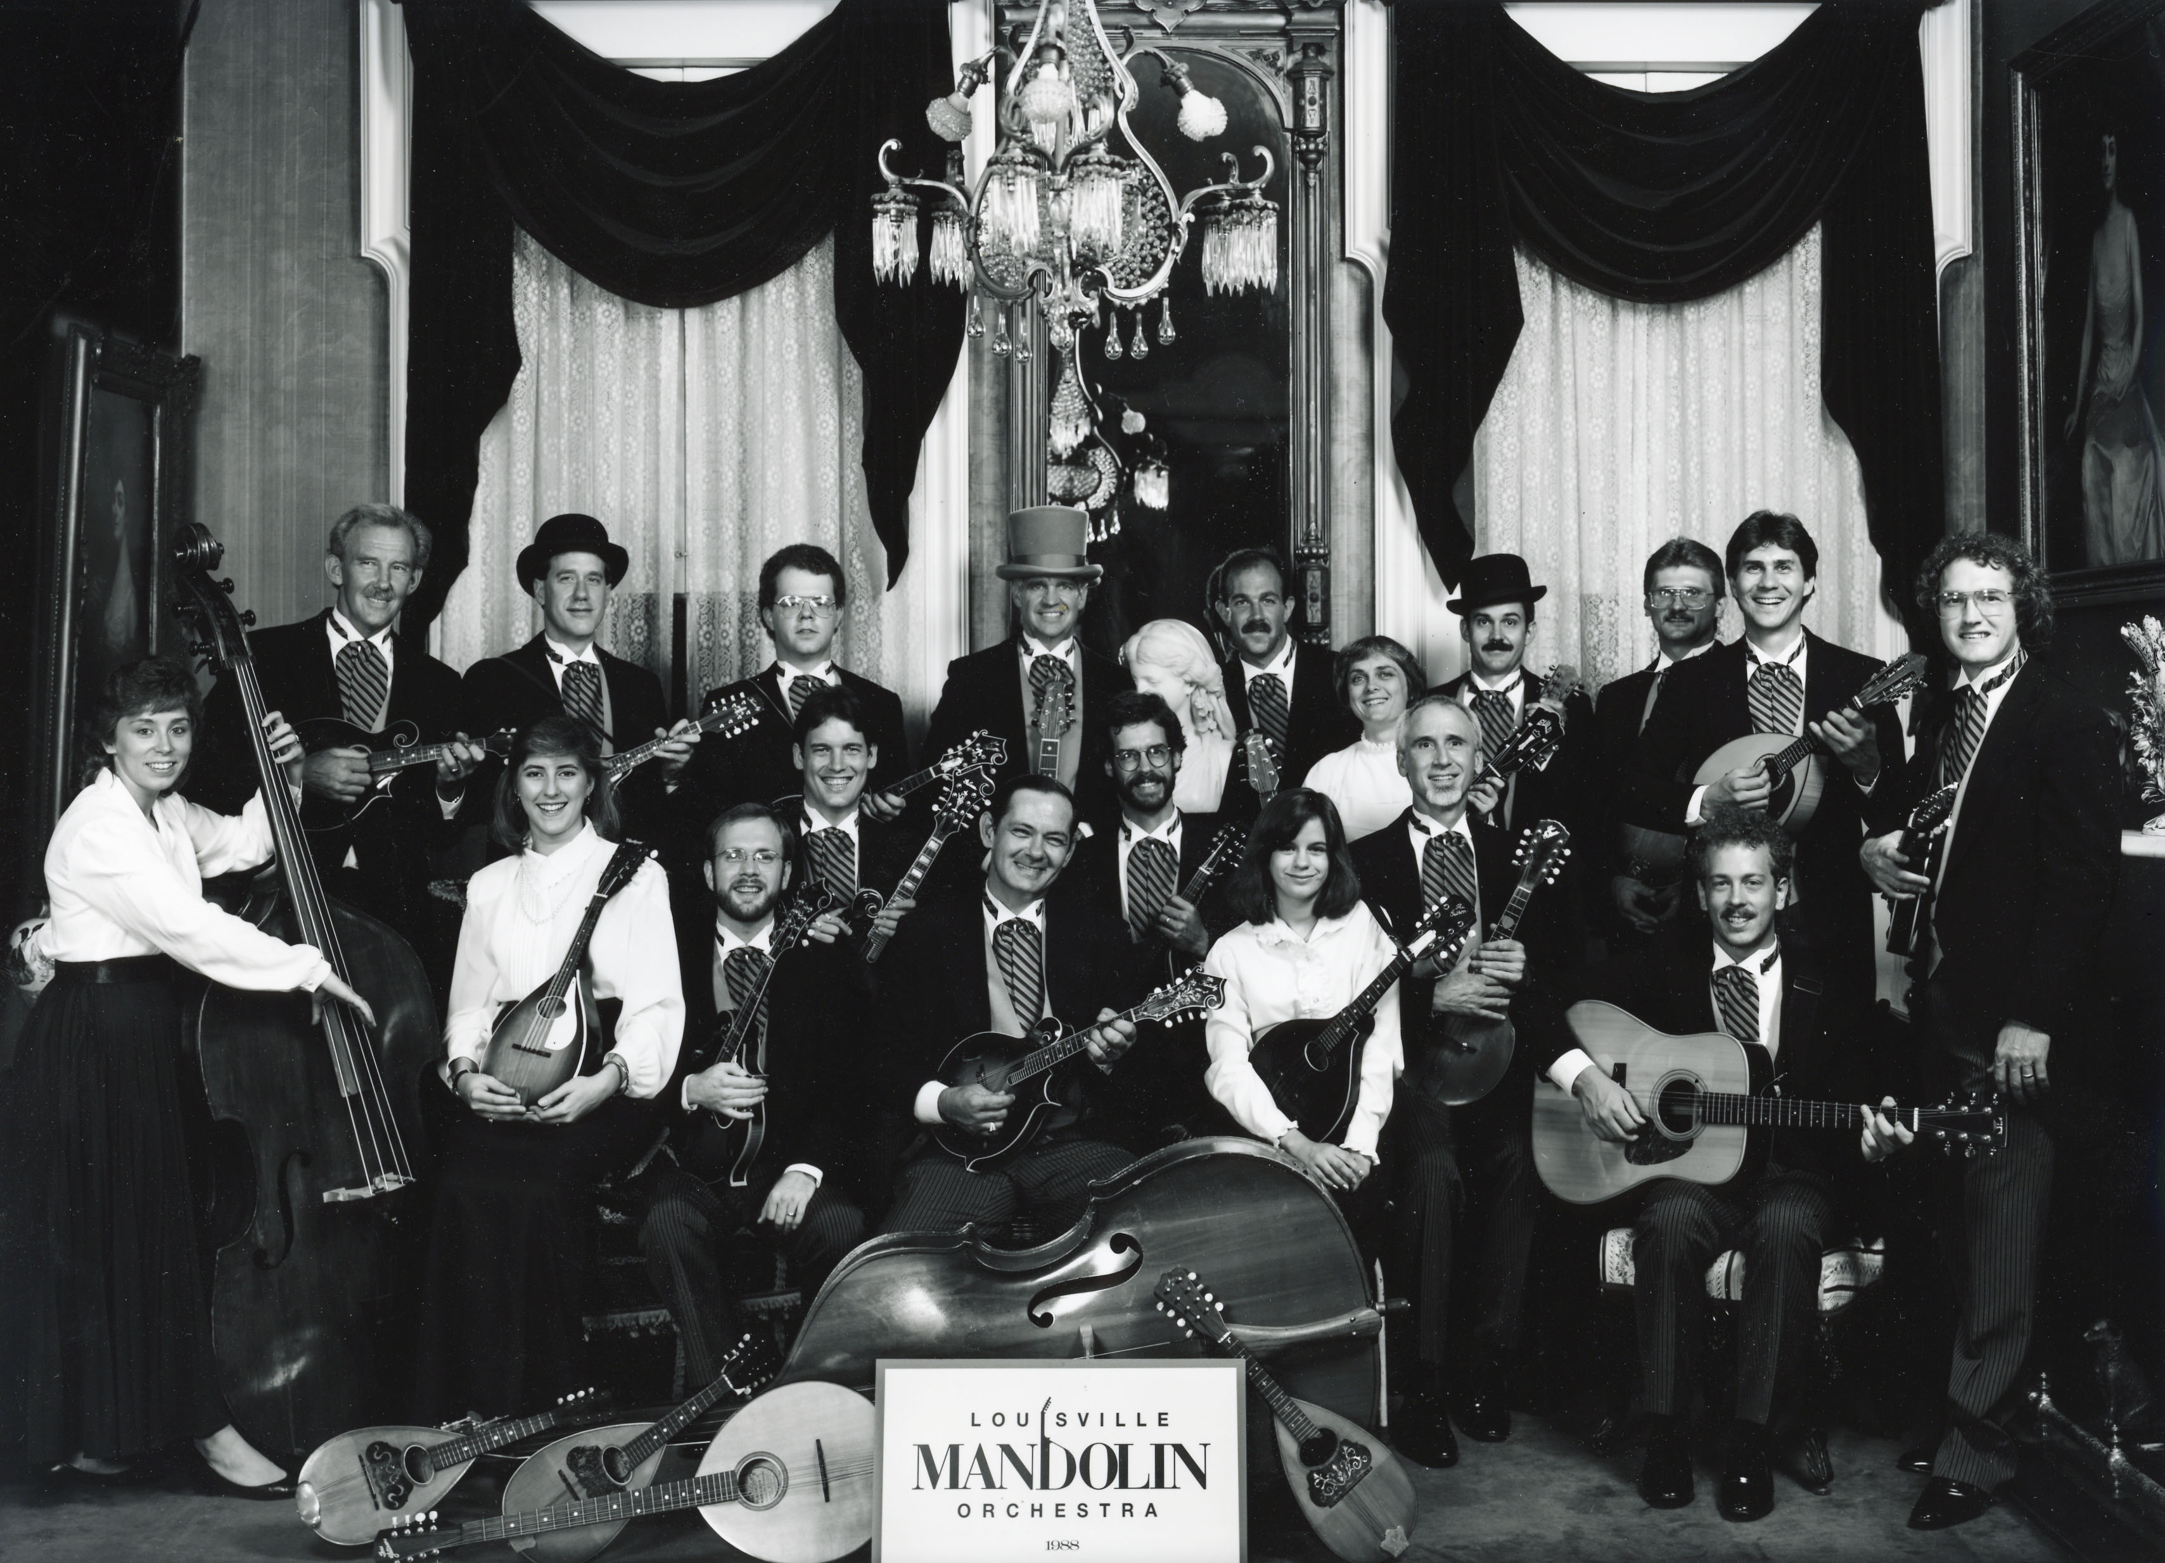
Notes:
Louisville Mandolin Orchestra - 1988

Slide 14
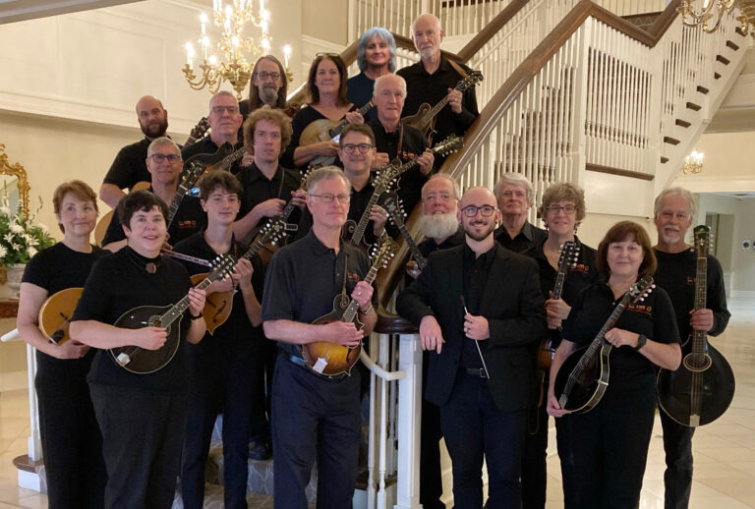
Notes:
Louisville Mandolin Orchestra - 2022

Slide 15
Louisville Mandolin Orchestra
Ascher Taylor-Schroeder, Conductor and Music Director
Special thanks to Joe Burch for technical assistance with this presentation.
For more information on the Louisville Mandolin Orchestra visit www.lmo.org
We welcome new members.

